Slide 1


REDDIT
CLIENT
By: Group 2
1

Slide 2

MEMBERS
Lê Việt Ân
22BI13009
Bùi Minh Đức
22BI13085
Phạm Ngọc Phương Anh
22BI13037
Nguyễn Đức Dũng
22BI13106
Phạm Chí Bách
22BI13055
Trần Mạnh Duy
22BI13126
2

Slide 3

TABLE OF CONTENTS
1
Introduction
2
Architecture
3
Activities
4
Network
5
Optimization
6
Demo
7
Conclusion
3

Slide 4


Introduction
INTRODUCTION
Architecture
Reddit - A media platform
Allows users to share content with others, participate in dicussions, engage in diverse communities
Community - “subreddit” - focused on specific interests
Post content while other users vote and comment threads
A vast range of topics
Activities
Network
Optimization
Demo
Conclusion
4

Slide 5
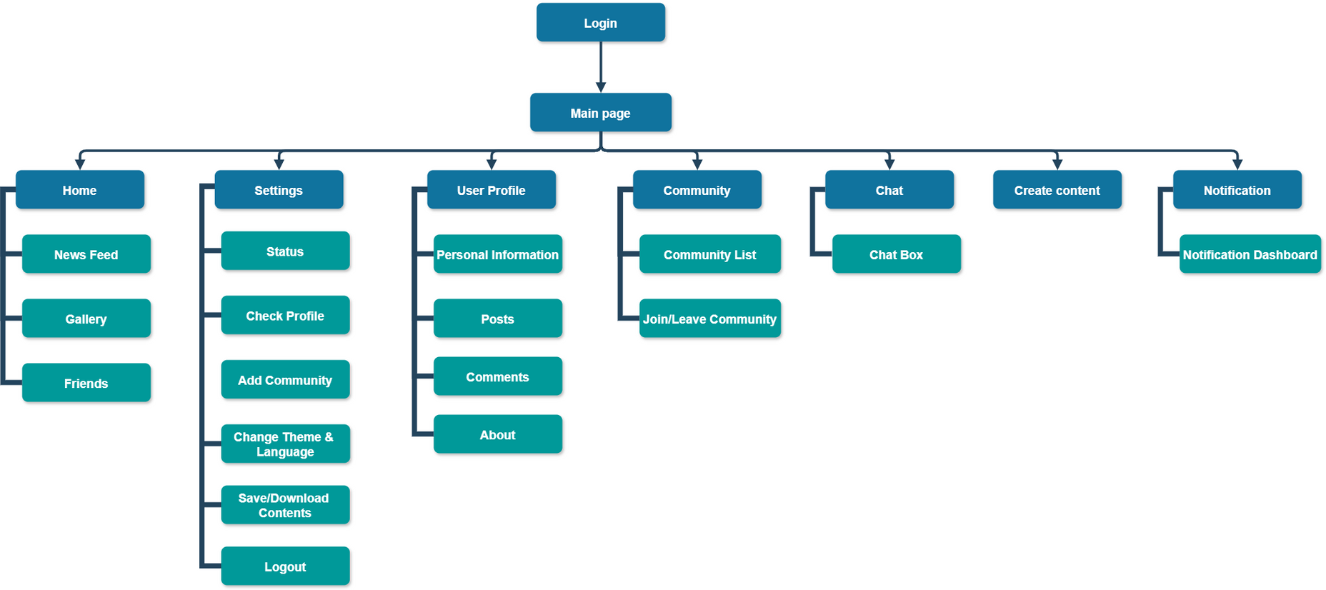
ARCHITECTURE
Architecture
Activities
Network
Optimization
Demo
Conclusion
5

Slide 6
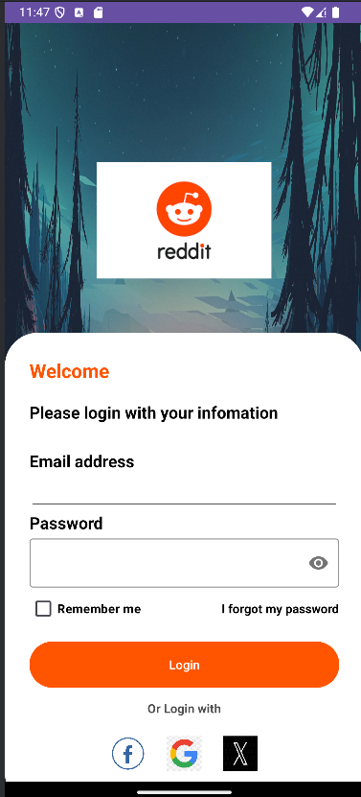

ACTIVITIES
Activities
Fill in the information
Tick “Remember me” to remember login information
Login
Link to Facebook/Google/X account
Network
Optimization
Demo
Conclusion
6

Slide 7
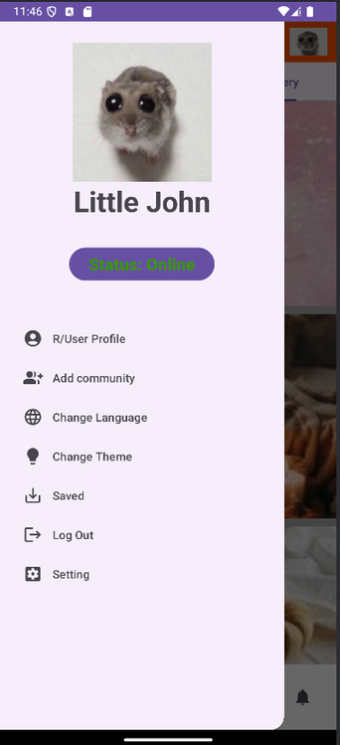
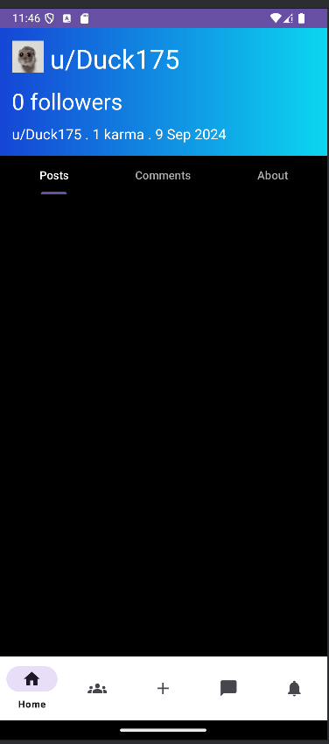
ACTIVITIES
Activities
Network
Click into the “User profile”
See your User profile
Optimization
Demo
Conclusion
7

Slide 8
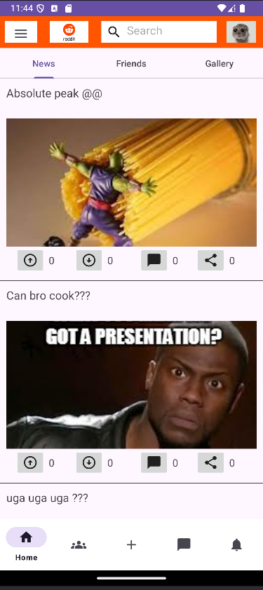
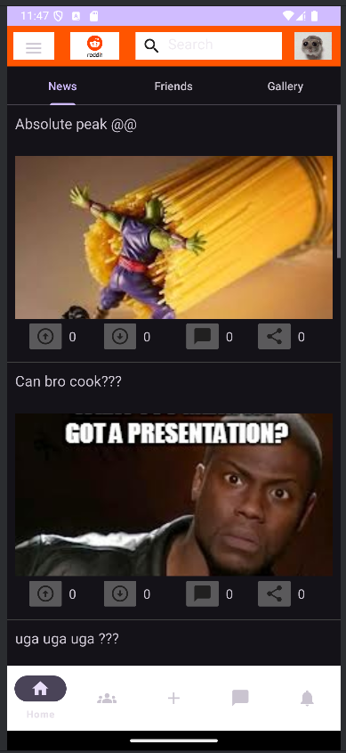
ACTIVITIES
Activities
Network
Click into the “Change Theme” to change the theme from light mode to dark mode
Optimization
Demo
Conclusion
8

Slide 9

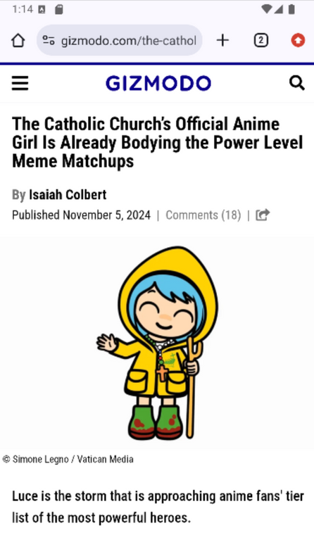
ACTIVITIES
Activities
Clicking the news will transfer to the full details of that news
Network
Optimization
Demo
Conclusion
9

Slide 10
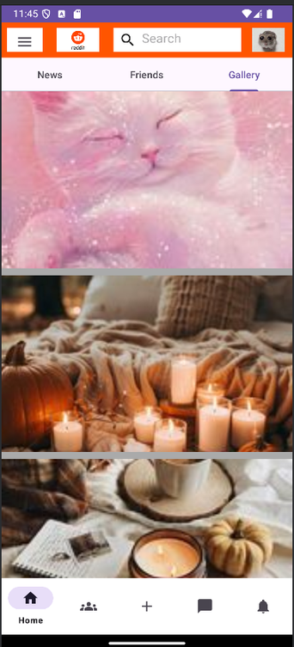
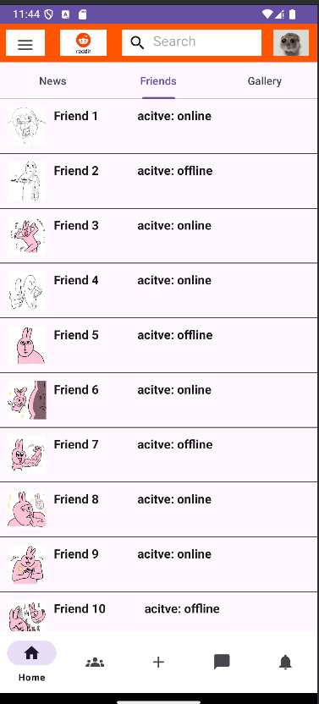
ACTIVITIES
Activities
Change to friend list, news and gallery layout - clicking News, Friends and Gallery.
Scroll down to see more informations.
Network
Optimization
Demo
Conclusion
10

Slide 11
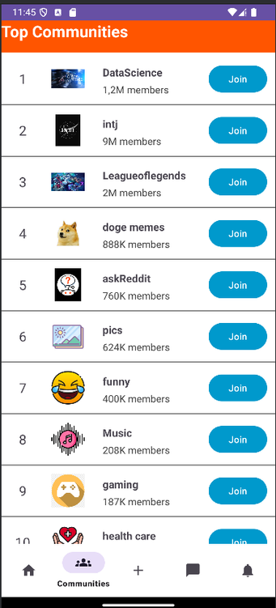
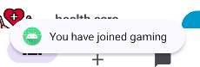
ACTIVITIES
Scroll down to find the community to join
Click into “Join” button to join that community
Activities
Network
Optimization
Demo
Conclusion
11

Slide 12
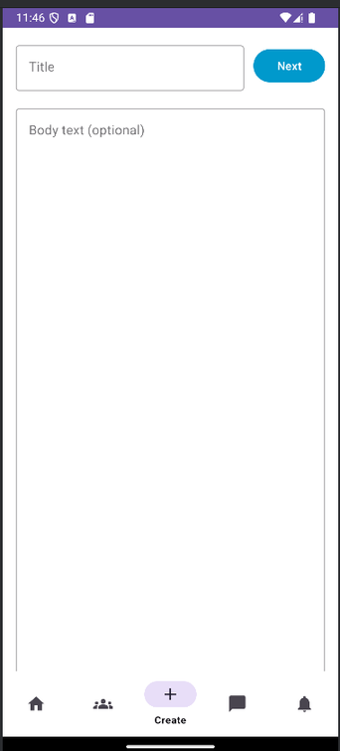
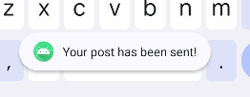
ACTIVITIES
Activities
Add title and content
Up your post.
Network
Optimization
Demo
Conclusion
12

Slide 13
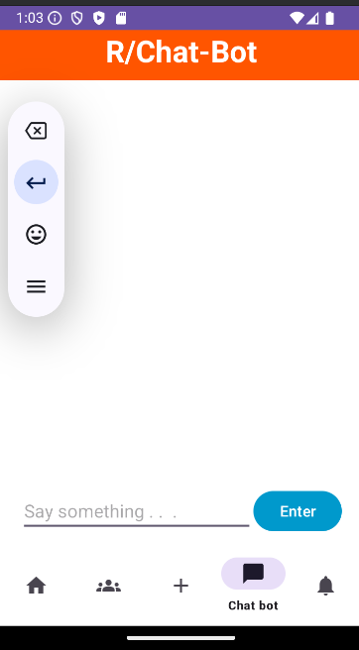
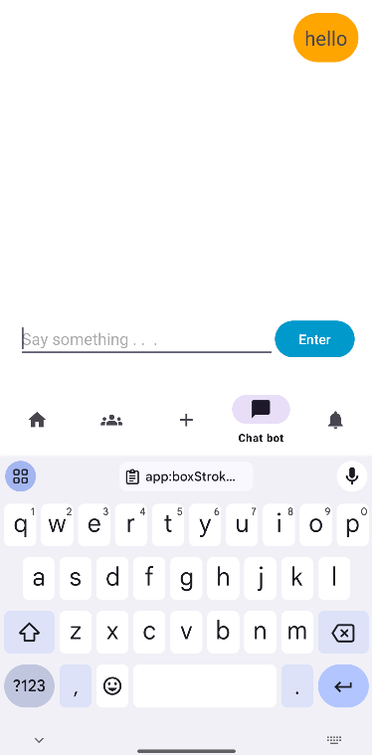
ACTIVITIES
Activities
Write messages
Click “Enter” to send the messages.
Network
Optimization
Demo
Conclusion
13

Slide 14
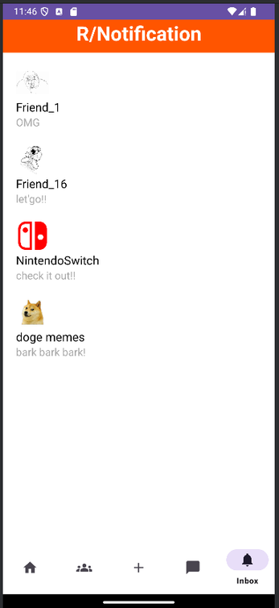
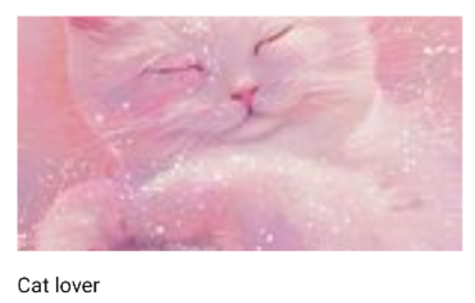
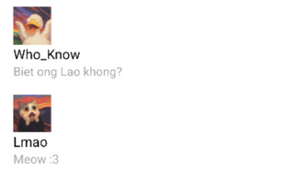
ACTIVITIES
Check notifications from friends and communities
Activities
Network
Optimization
Demo
Conclusion
14

Slide 15

NETWORK OVERVIEW
External sources - load images or data.
Articles and images - fetched from APIs and external image sources
Retrofit for data fetching and Glide for image loading.
Async Access: Glide and Retrofit handle network calls asynchronously - avoid blocking main UI
REST APIs (like Pexel API or News API): using HTTP requests to fetch JSON data
Network
Optimization
Demo
Conclusion
15

Slide 16
NETWORK
API Setup and Fetching Data
Library: Retrofit for HTTP requests
Implementation:
NewsApiService defines API endpoints
Ex: Fetching articles via Call<ArticleResponse>
Asynchronous Requests: use enqueue() for network responses
Network
Optimization
Demo
Conclusion
16

Slide 17
NETWORK
Network Data Handling
Data Conversion: Models like Article and ArticleResponse
Response Handling
Error and Image Handling
Showing user-friendly messages on failures
Glide integration for efficient image fetching
Network
Optimization
Demo
Conclusion
17

Slide 18
OPTIMIZATION
Image Loading Optimization (Glide)
Display during slow loads or failures.
Automatically cache images in memory/disk
Control memory usage by loading optimized sizes.
Optimization
Demo
Conclusion
18

Slide 19
OPTIMIZATION
Data Fetching Optimization (Retrofit)
Caching Responses - reduce redundant network calls for repeated data access
Use query parameters and pagination to reduce data transfer
API Requests Optimization
Retry & Backoff
Optimization
Demo
Conclusion
19

Slide 20
OPTIMIZATION
Minimizing Network Calls
Lazy Loading
Prefetching
Monitoring & Profiling
Android Profiler - track and optimize network usage, eliminating redundancies
Optimization
Demo
Conclusion
20

Slide 21
CONCLUSION
What we have done
Create a Reddit Mobile app with fudamental features and do some updates
Create API to fetch data from Internet
Know how API works
Difficulties
Some features are not done yet
Post Voting and Comment Threads
Search & Create Contents
Community
UI and Thread are still slow
Conclusion
21

Slide 22
CONCLUSION
Future works
Finish and update the undone features
Create some new features and functions
Fix bugs
Conclusion
22

Slide 23
DEMO
Conclusion
Demo
23

Slide 24

THANK YOU
24

